Slide 1
The Dash to Diagnose Diabetes
Assisting with early detection of diabetic or pre-diabetic patients, along with those at risk

Slide 2



Background
a
Client is one of the largest southern healthcare provider networks
- Accepts all forms of insurance, including Medicare & Medicaid
- Facilities over capacity since the pandemic began
Notes:
Accepts Medicaid

Slide 3
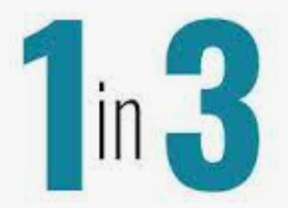


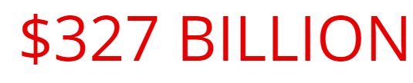
Diabetes in Dollars
Total Spending
1
$
Population Impact
out of every
$4
Prediabetic - 1/3 of population
Fully diabetic: 13% *
*1/5 of which are undiagnosed
spent on US healthcare is diabetes-related
Economic Cost Growth
Complications & Care
Heart disease
Stroke
Dialysis
rose 60% from 2007 to 2017
Cost Breakdown
Prevention & Early Detection
Direct medical:
Reduced productivity:
$90 BILLION
If uncontrolled, permanent organ damage is possible.
Notes:
Diabetes is the most expensive chronic condition in our nation. $1 out of every $4 in US health care costs is spent on caring for people with diabetes
Complications & care: 48% to 64% of lifetime medical costs for a person with diabetes are for complications related to diabetes, such as heart disease and stroke.¹⁷
- https://www.cdc.gov/chronicdisease/programs-impact/pop/diabetes.htm#:~:text=The%20High%20Cost%20of%20Diabetes,chronic%20condition%20in%20our%20nation.&text=%241%20out%20of%20every%20%244,caring%20for%20people%20with%20diabetes.&text=%24237%20billion%E2%80%A1(c)%20is,(c)%20on%20reduced%20productivity.
https://www.ncbi.nlm.nih.gov/books/NBK567967/#:~:text=Percent%20Distribution%20of%20Payment%20for%20Medical%20Care%20Expenses&text=The%20majority%20of%20dental%20visits,13.5%25%20paid%20by%20private%20insurance.
https://www.cdc.gov/chronicdisease/resources/publications/factsheets/diabetes-prediabetes.htm

Slide 4
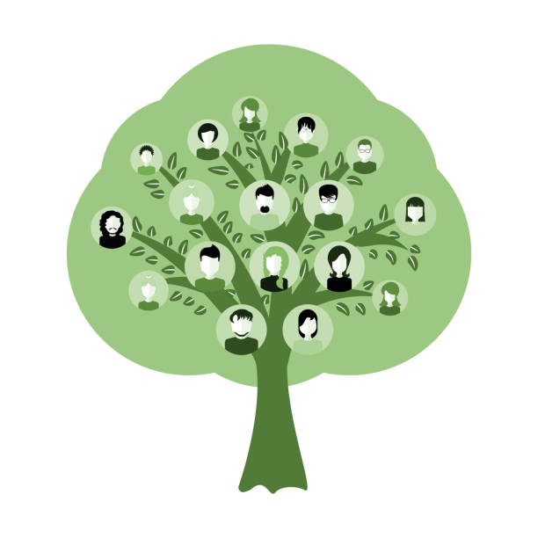

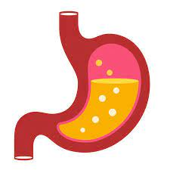


Dataset: Diabetes Health Indicators from Kaggle
250,000+ rows
21 unique features for targets
Target = status as pre-diabetic or diabetic
Demographics
Age, Gender, Education, Income
Mental Health
Mental well-being & overall health ratings
Diet
Fruit, Veggie, Alcohol Consumption
Health History
history of heart disease, stroke, and/or smoking
Activity
Exercise, Difficulty walking upstairs,
Recall = primary metric
Notes:
250,000 + rows
21 features outside target
Feature engineering reduced this to 14 for log reg & one knn model
Explain why recall is primary metric

Slide 5
Subsets & Imbalances
Notes:
The Behavioral Risk Factor Surveillance System (BRFSS) is a health-related telephone survey that is collected annually by the CDC. Each year, the survey collects responses from over 400,000 Americans on health-related risk behaviors, chronic health conditions, and the use of preventative services. It has been conducted every year since 1984. For this project, a csv of the dataset available on Kaggle for the year 2015 was used. T

Slide 6
Algorithms, Tools, Steps
2
4
Try sampling techniques to counteract imbalanced data.
Use GridSearchCV to tune parameters of preferred models. Rescore, plot ROC-AUC curves.
1
3
5
Splitting data to create 2 binary databases. Splitting again for feature-engineering vs non-FE.
Scale data & train sklearns classifiers (Knn-neighbors, decision trees, random forests, logistic regression, extra trees).
Use log-loss for confidence estimate. Determine most impactful features.
Notes:
Score each model; focus on recall & precision

Slide 7
Findings
Earth
Recommended model for Diabetes prediction
Log Reg had best ROC_AUC curve, but the worst scores.
It’s the third planet
from the sun
Recommended model for Pre-Diabetes Detection
Random Forests & Extra Trees Classifiers
Decision Trees
Classifier Model | Target Diabetic Level | Recall | Precision | Accuracy | F1_Score | ROC_AUC | Sampling Method
Random Forest | Full | 63% | 58% | 46% | 57% | 71% | Oversample
Extra Trees | Full | 63% | 57% | 69% | 57% | 71% | SMOTE
Decision Trees | Pre- | 53% | 51% | 56% | 49% | 52% | Undersample
1995
60%
Saturn
2000
It’s a gas giant with an average radius of about nine times that on Earth
88%
2005
2000
2010
2015
30%
Venus is the closest planet to the sun
2010
Uranus is the seventh planet from the Sun
46%
Notes:
-Feature engineering worked best, even on tree models.
Trees usually can split out the natural overap of the r aw data, but here they did not.Overlapping and correlated values confused the machine learning models

Slide 8
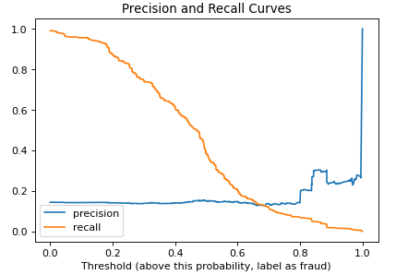
Threshold & Confusion Matrix
 | PREDICTED No | PREDICTED Yes
ACTUAL No | 1783 | 62205
ACTUAL Yes | 401 | 10326
Notes:
Sacrifices accuracy

Slide 9
Feature Interpretation
# | Features | Target Impact
1 | BMI | 20.4%
2 | Average Education & Income | 13.8%
3 | Age | 13.4%
4 | Days without medical problems | 9.2%
5 | Self-reported general health estimate | 7.8%
6 | Days without mental health illnesses | 6.9%
7 | High Blood Pressure & Vegetable | 6.8%
8 | Daily Fruit and/or Vegetable Consumption | 5.2%
9 | Remains active, does not have difficulty walking up stairs | 4.2%
10 | Ever been a smoker | 3.2%
11 | Gender | 2.8%
12 | Has healthcare/ does not go to doc because of cost / has not had cholesterol check in 5 years | 2.3%
13 | HeartDiseaseorAttack | 2.1%
14 | Stroke | 1.2%
15 | HvyAlcoholConsump | 0.8%
Notes:
Alcohol lower than expected
Mental health was high on the list; may be correlated with numbers 5 and 4 though

Slide 10
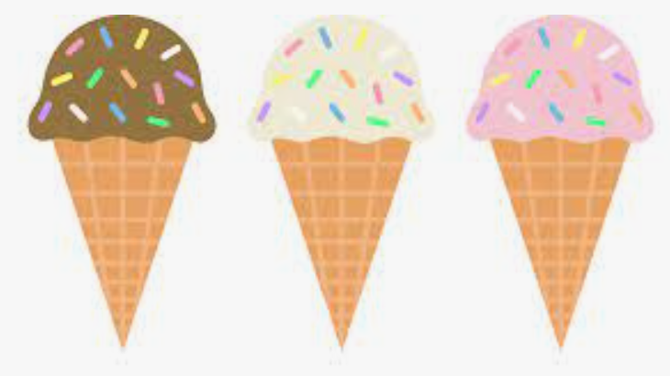


Conclusions
Model can achieve 65% recall for full-diabetics, and 51% for pre-diabetics.
Not a replacement, but an addition to medical professionals sifting through lots of data
Heavy alcohol assumption lowered than imagined – high correlation with the others/feature engineering probem?
See below future work.
Future Work
1
Continue Feature Engineering
Explore Multinomial Classifiers
Optimize all models
2
3
Notes:
Solve for potential other collinear problems
Gridsearchcv continuation with other models
multinomial

Slide 11
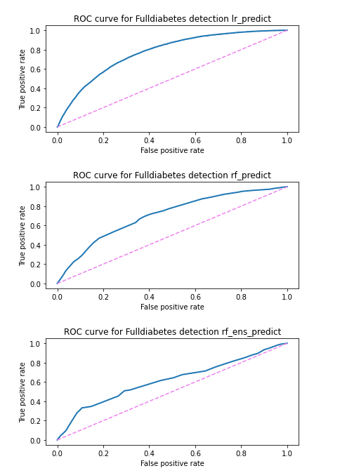
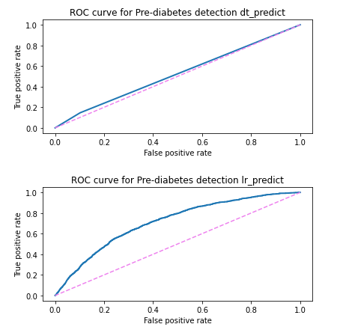
Appendix: ROC_AUC Curves

